Slide 1
May 26, 2026
Project Title: University Central Student Portal with Virtual Assistant
Made by Rajendrasingh Rajpurohit

Slide 2
Index
1. Project Submission Report Details
2. Project Objective & Description
3. Technologies Used
4. Screenshots with Explanation
5. Project Links
6. Conclusion & Summary

Slide 3
1. PROJECT SUBMISSION REPORT DETAILS
Student Credentials
Project Title: University Central Student Portal with Virtual Assistant
Student Name: Rajendrasingh Rajpurohit
Program:Lenovo LEAP NextGen Scholar Program
Course / Batch: Artificial Intelligence / June 2026
Submission Date: /06/2026

Slide 4
2. Project Objective & Description
Objective: To create a unified desktop portal where students can view academic dashboards, access course records and grades, and get instant answers to common campus questions through a virtual assistant.
Description: A Tkinter-based student portal featuring three integrated modules: a Dashboard with announcements and GPA overview, a Course Database displaying enrolled courses with grades, and a Virtual Helpdesk Bot that responds to FAQs about IT, tuition, shuttle schedules, and health services. The application uses a sidebar navigation system with a collegiate burgundy and gold color theme.

Slide 5
3. Technologies Used
Python 3.12: Primary programming language for application logic and navigation.
Tkinter Library: GUI framework for windows, sidebar, chat interface, and tables.
VS Code: IDE used to write, debug, and run the code.
Object-Oriented Event Handling: Class-based pages and command buttons for frame switching and chatbot replies.

Slide 6
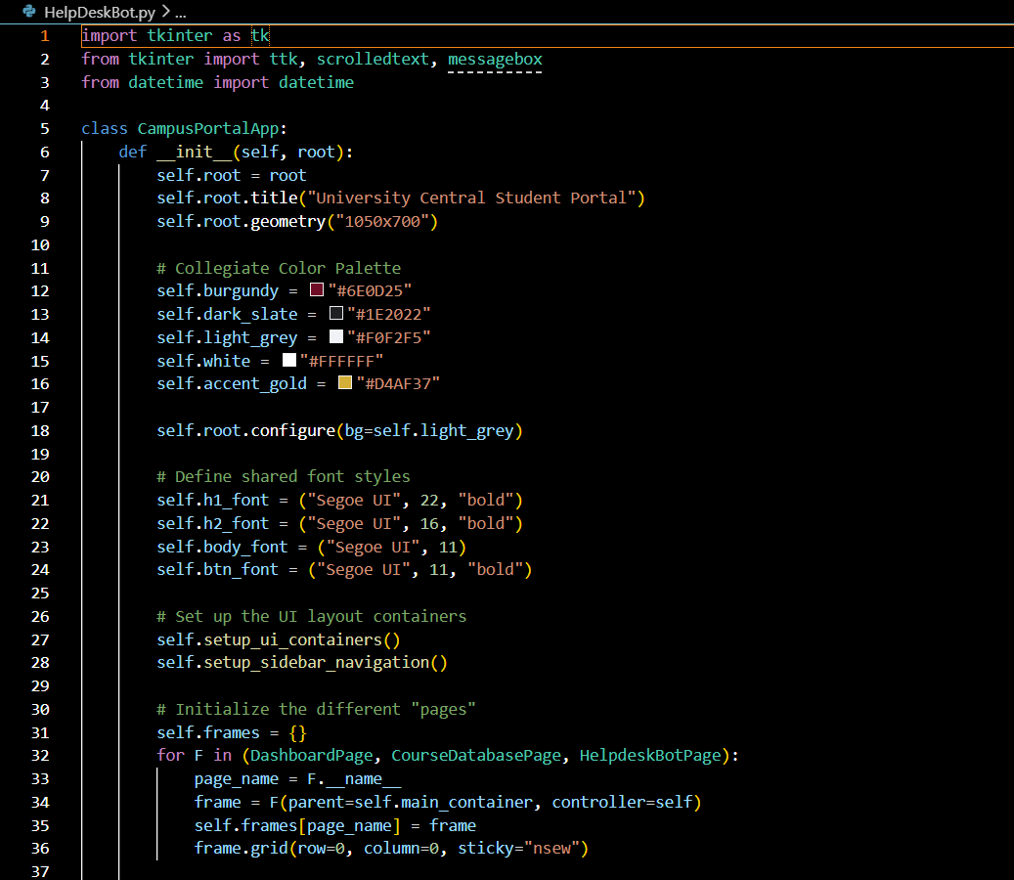
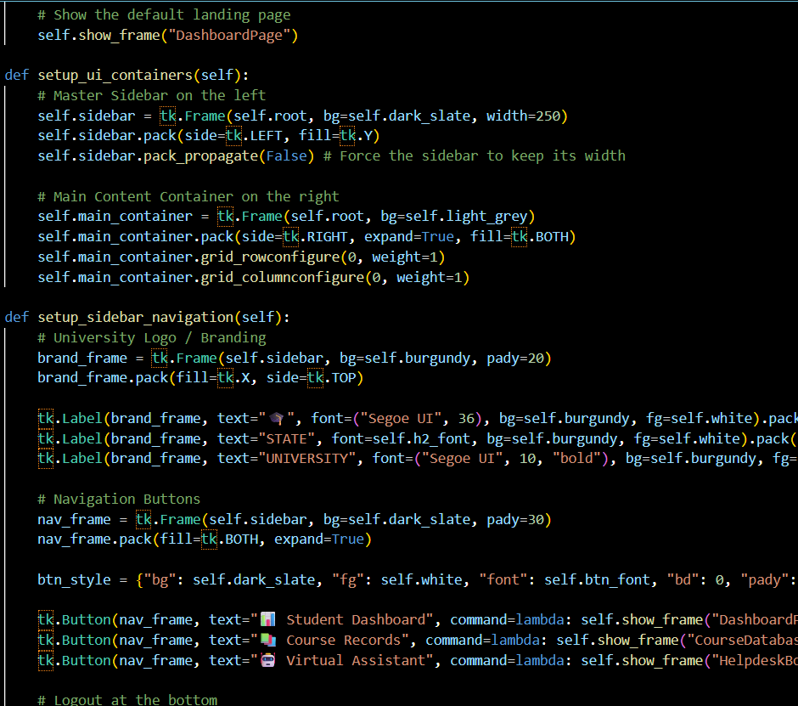
4. Screenshots with Explanation
Code Screenshots 1 and 2

Slide 7
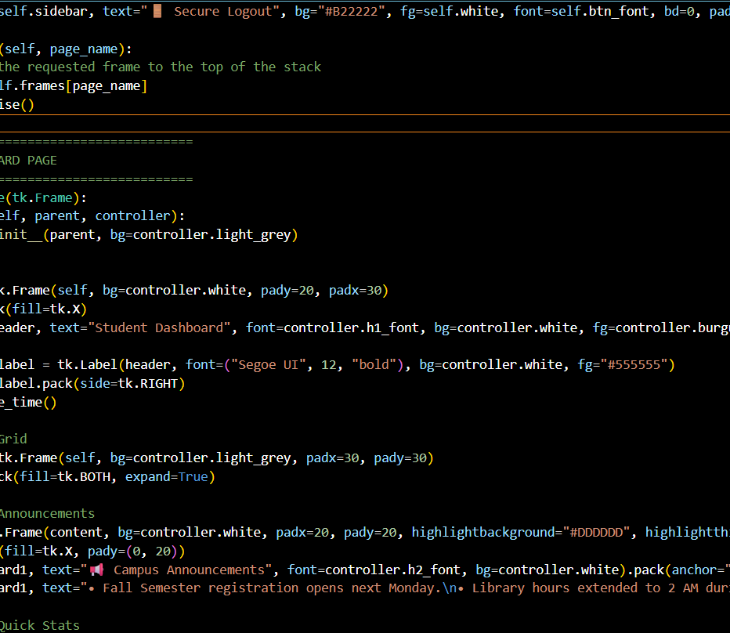
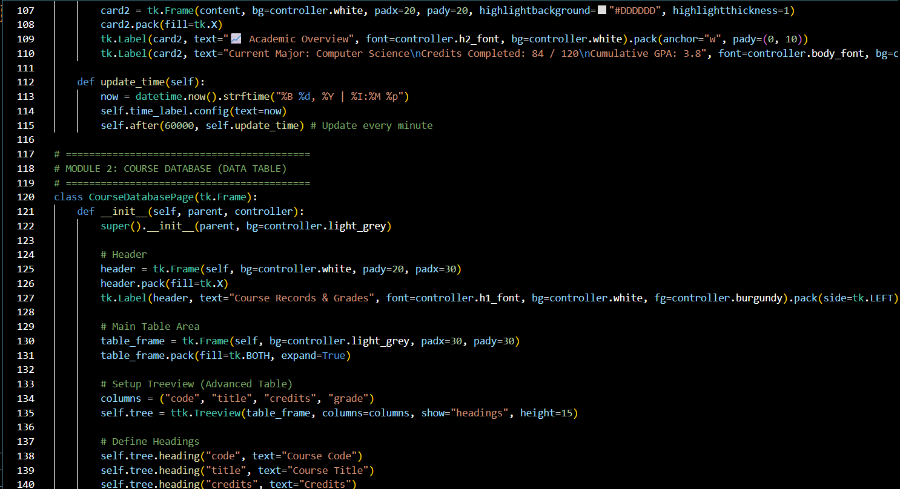
4. Screenshots with Explanation
Code Screenshots 3 and 4

Slide 8
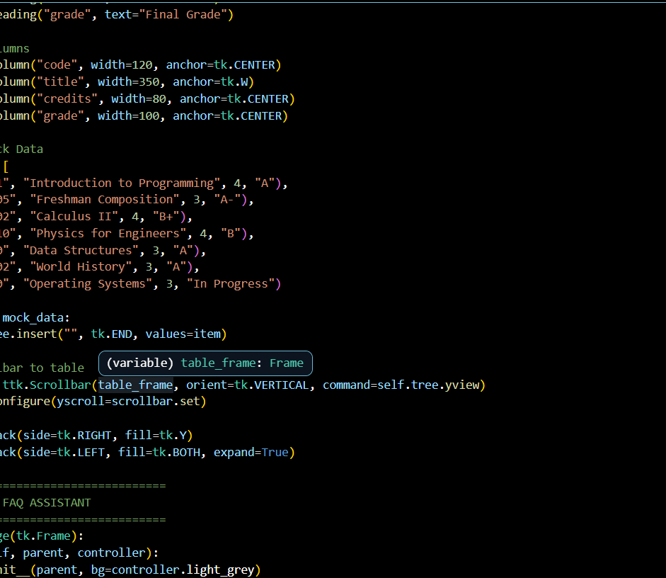
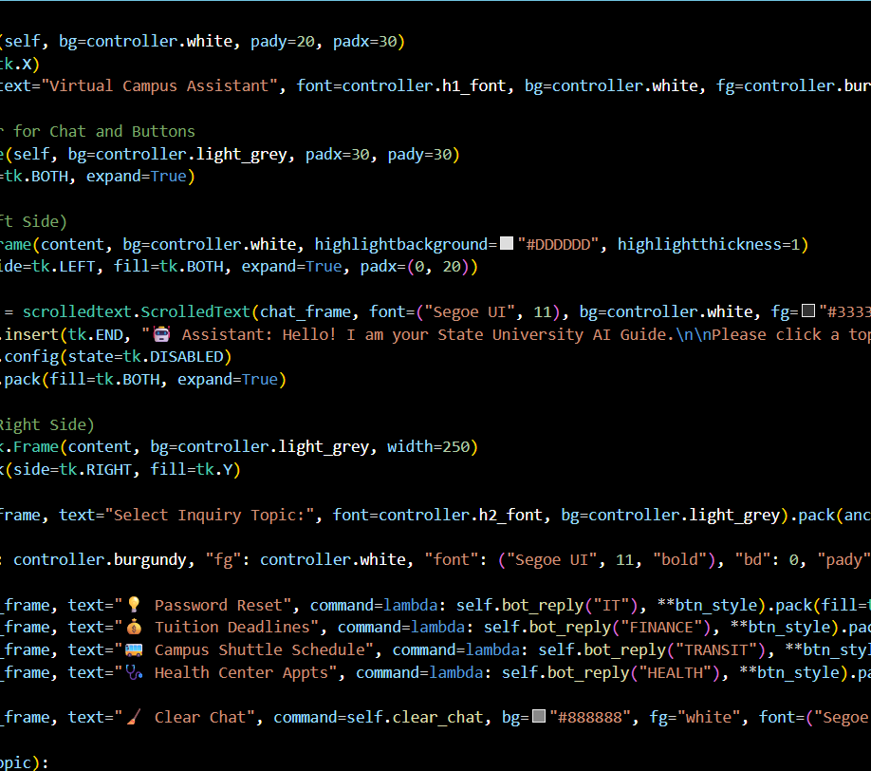
4. Screenshots with Explanation
Code Screenshots 5 and 6

Slide 9
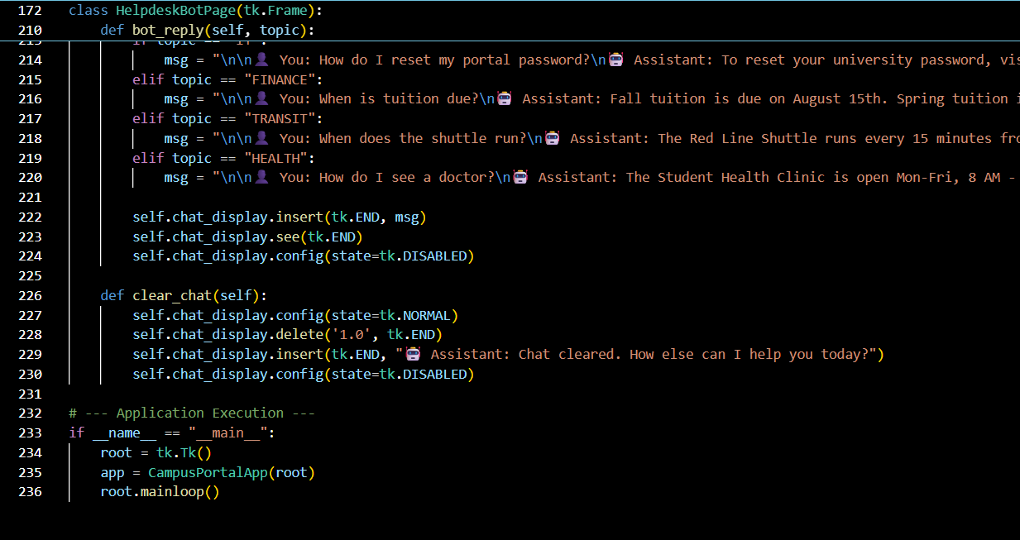
4. Screenshots with Explanation
Code Screenshot 7

Slide 10
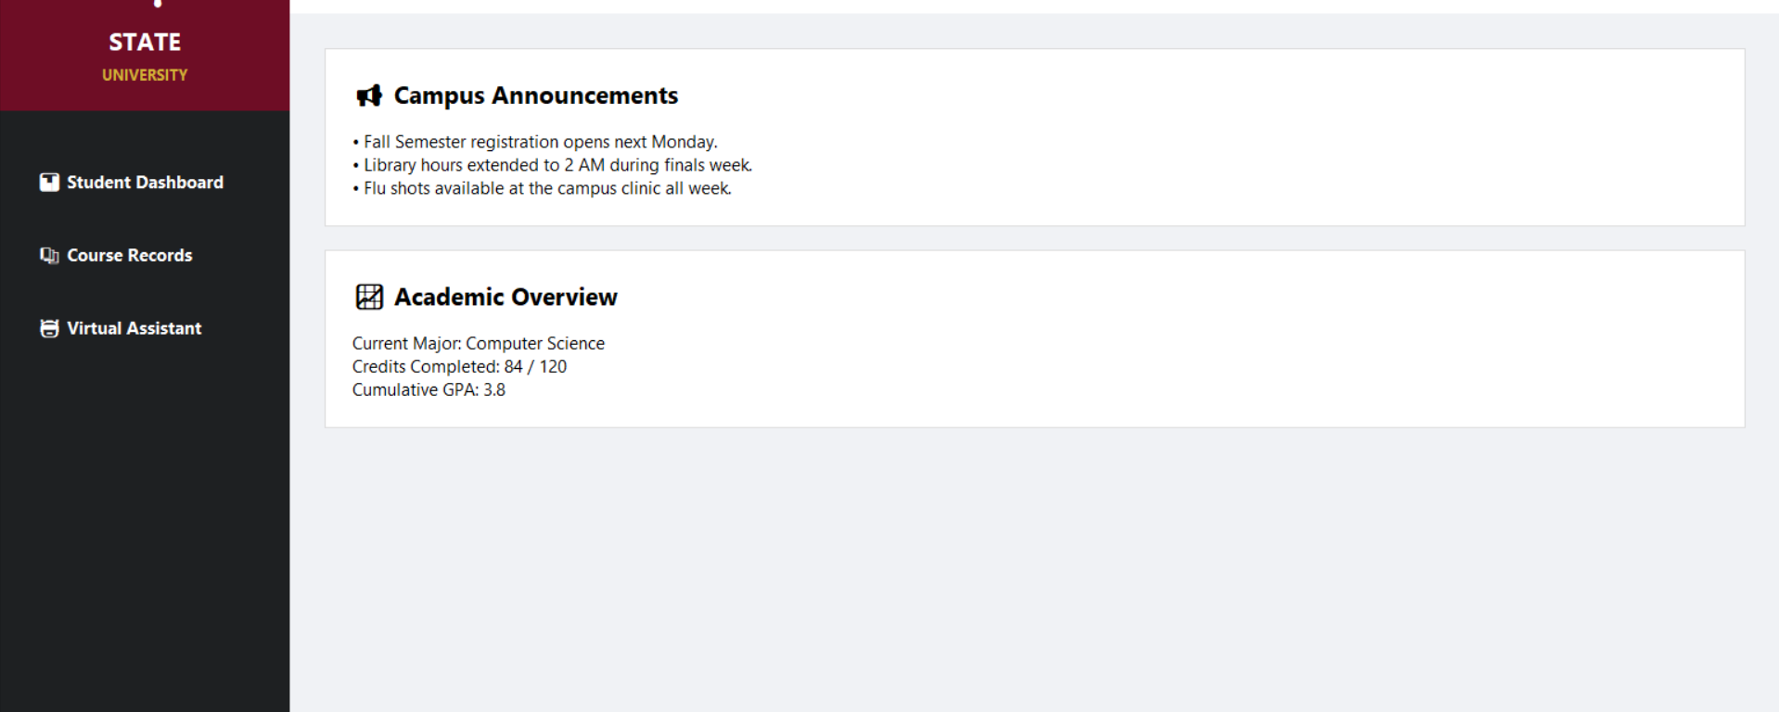
4. Screenshots with Explanation
Output

Slide 11
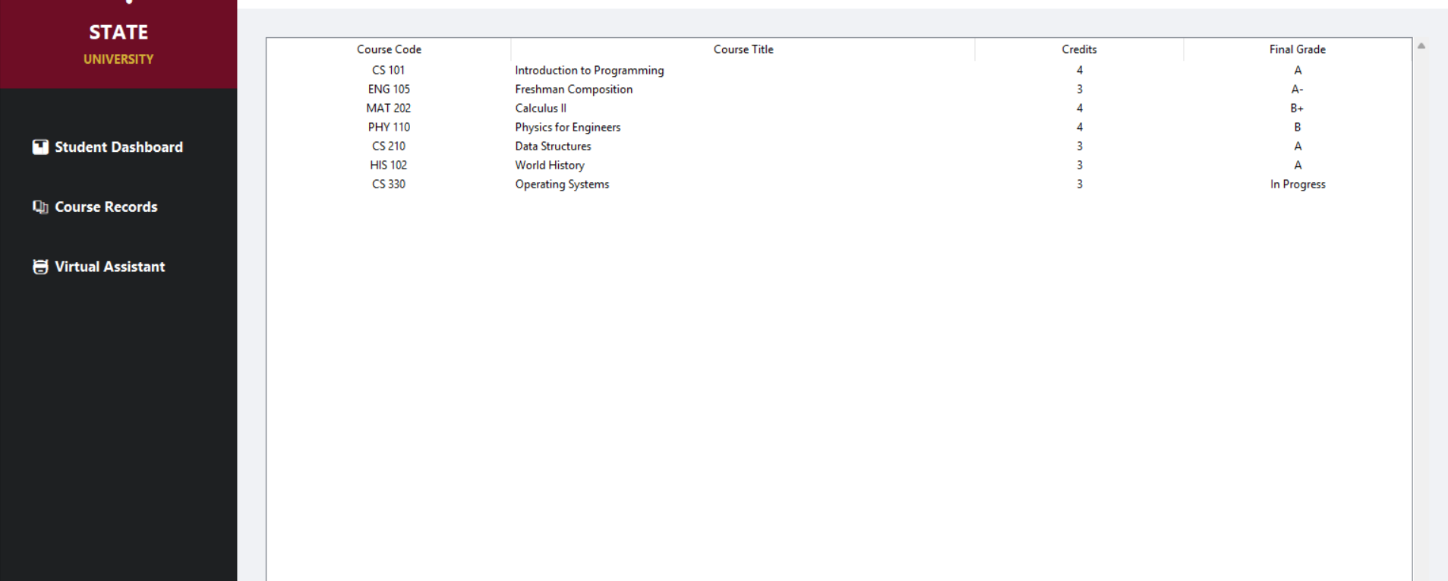
4. Screenshots with Explanation
Output

Slide 12
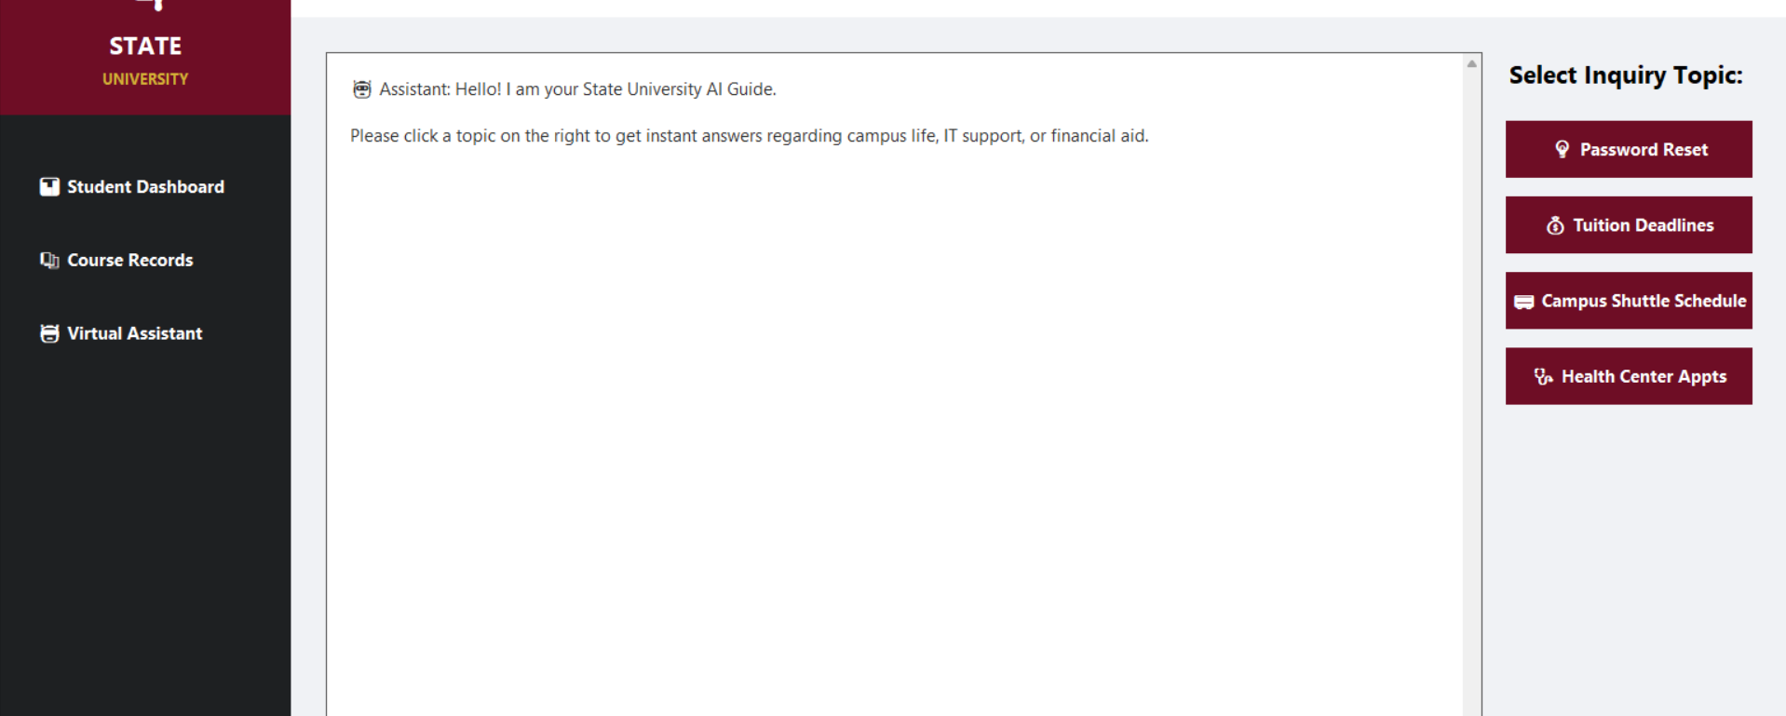
4. Screenshots with Explanation
Output

Slide 13
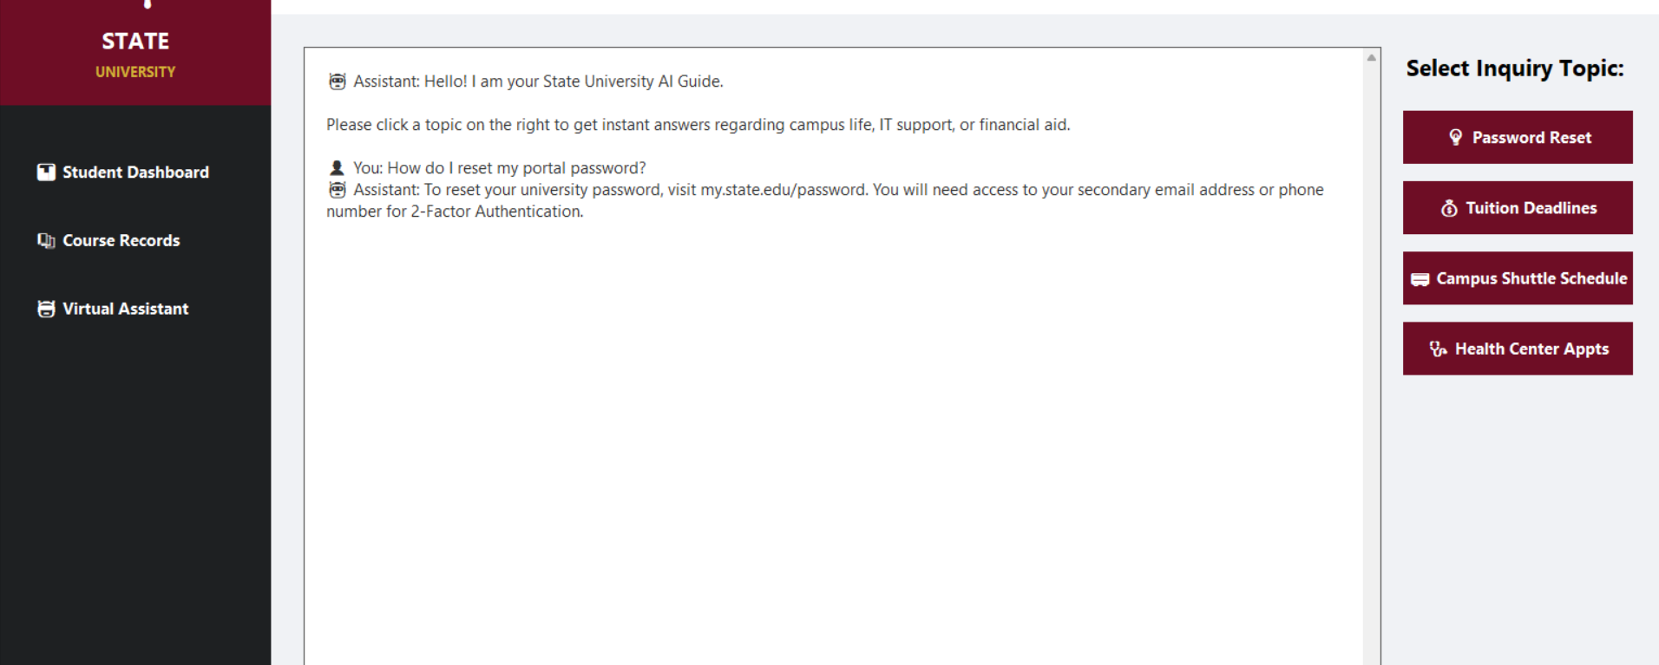
4. Screenshots with Explanation
Output

Slide 14
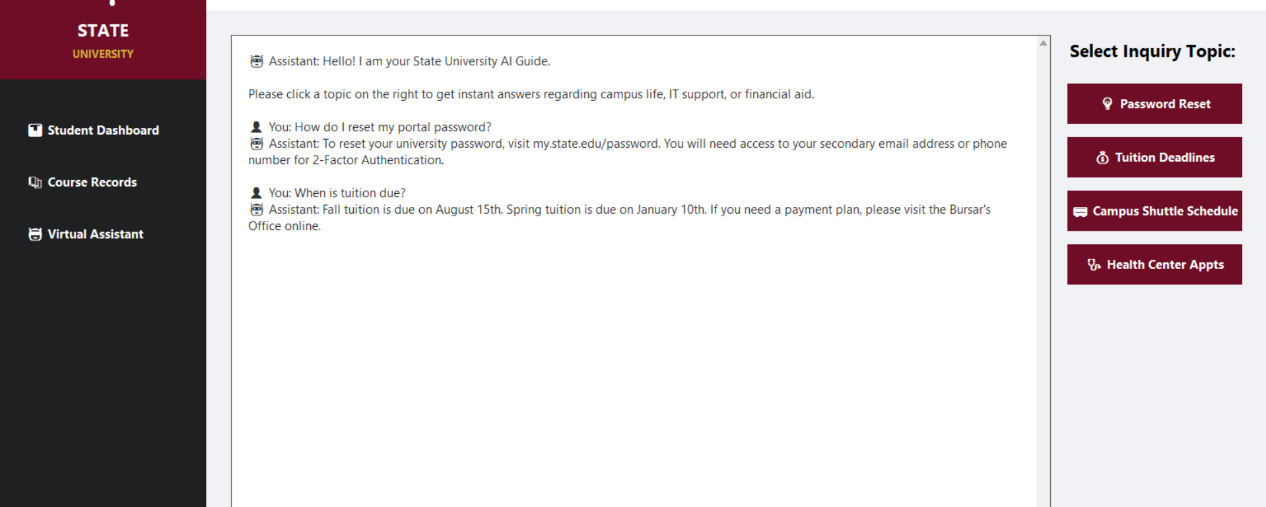
4. Screenshots with Explanation
Output

Slide 15
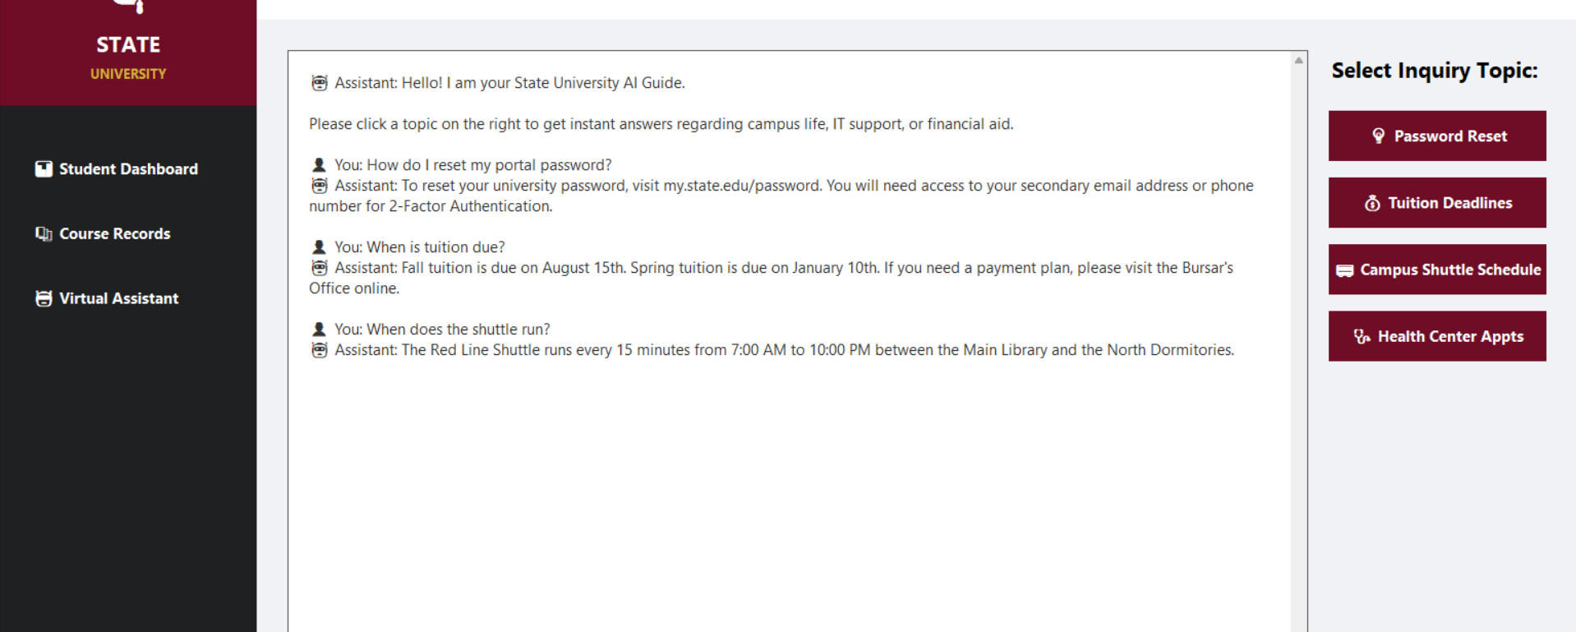
4. Screenshots with Explanation
Output

Slide 16
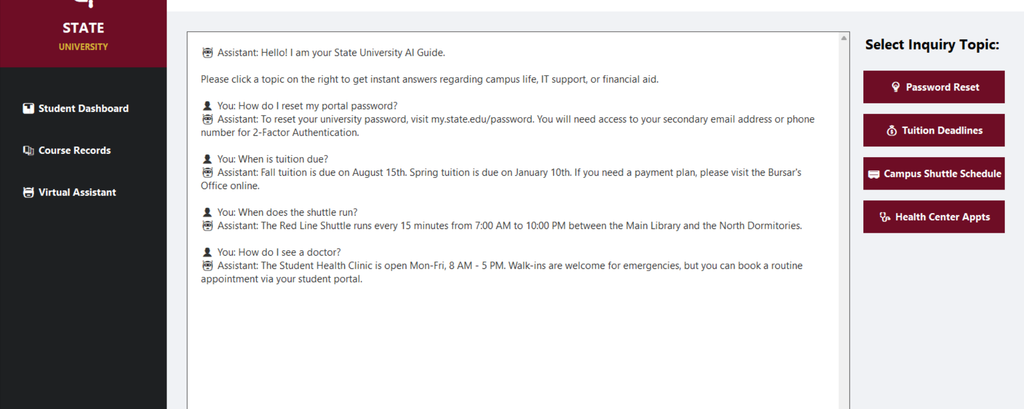
4. Screenshots with Explanation
Output

Slide 17

5. Project Links
Github Link: https://github.com/Raju1234raj/Campus-Bot
Development Platform: Visual Studio Code IDE Local Environment.

Slide 18
6. Conclusion & Summary
Project Outcomes: The project successfully delivers a fully functional three-in-one student portal with a responsive sidebar navigation system. The dashboard displays real-time clock updates and academic summaries, the course database presents scrollable grade records, and the virtual assistant responds accurately to four FAQ categories without any crash or input errors.
Key Learnings:
GUI Frameworks: Learned to design multi-page interfaces using Tkinter frames, manage window geometry, and implement custom color palettes for professional branding.
State Control Logic: Mastered frame switching with tkraise() and event-driven button commands to navigate between different pages without opening new windows.
Data Presentation: Gained experience using the Treeview widget to display structured tabular data with scrollbars and column formatting.
User Experience Design: Discovered that button-driven interactions eliminate typing errors and provide a more intuitive experience compared to command-line interfaces.

